Slide 1
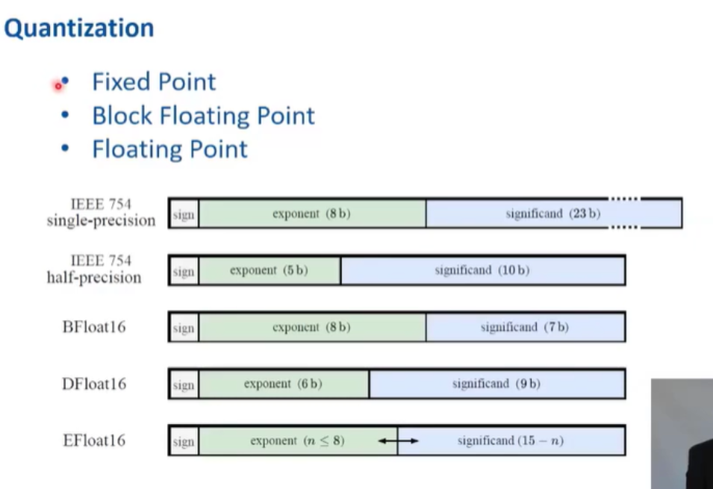
Practical Applications

Slide 2
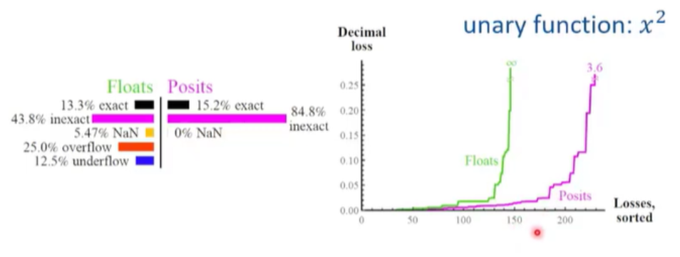
Practical Applications

Slide 3
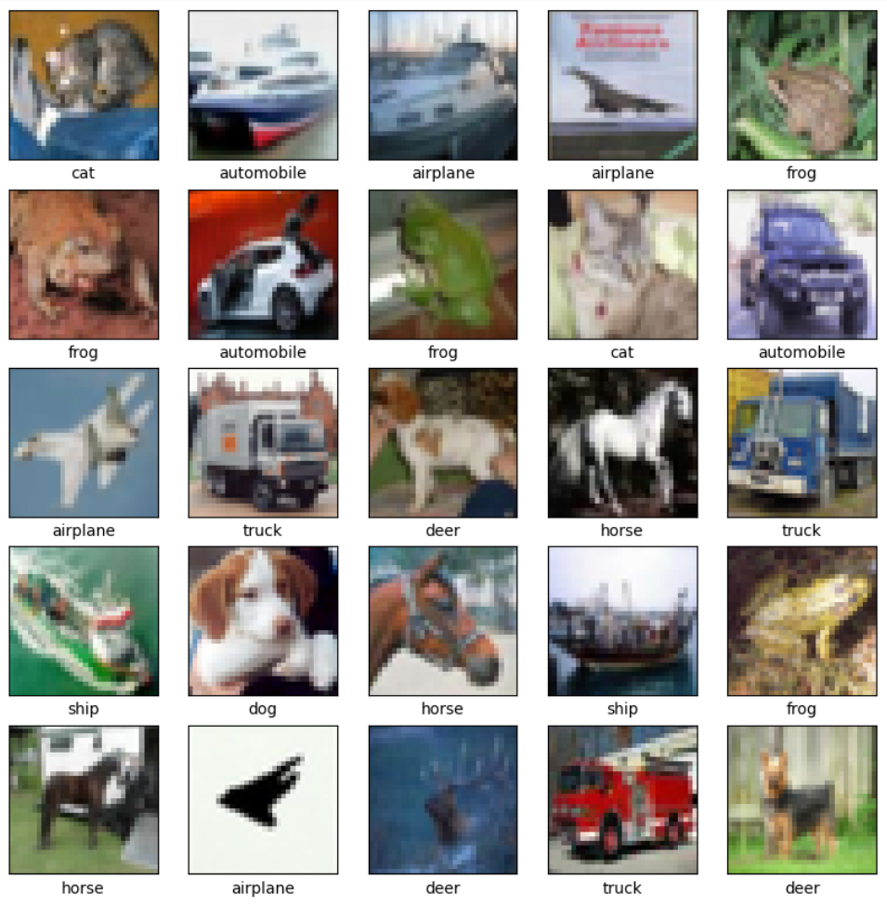
Real Life Examples

Slide 4
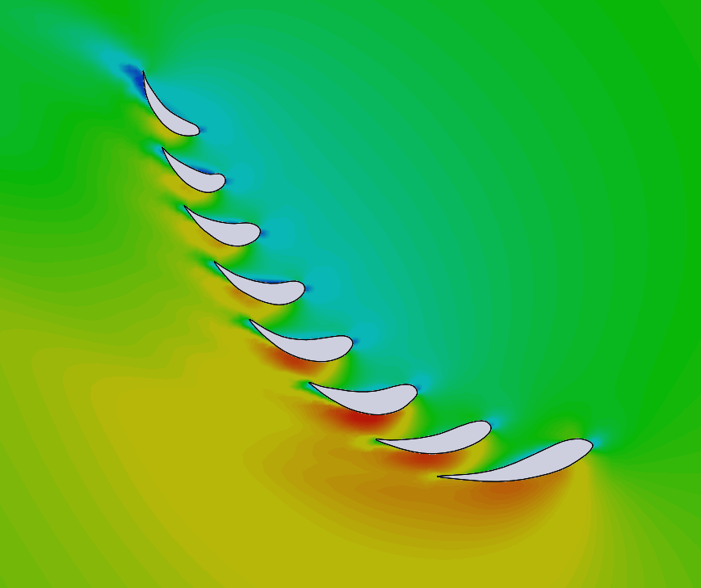
Real Life Examples

Slide 5
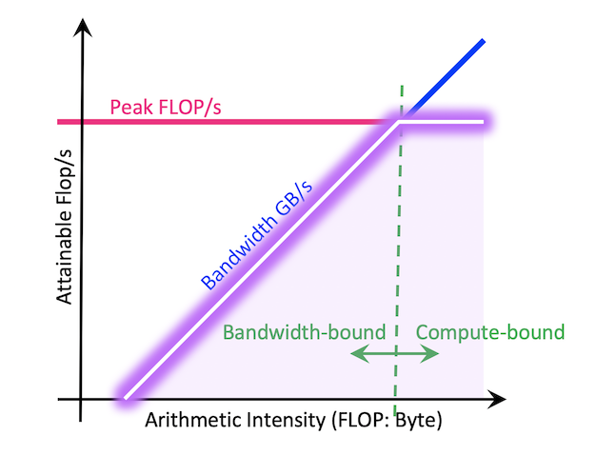
Real Life Examples

Slide 6
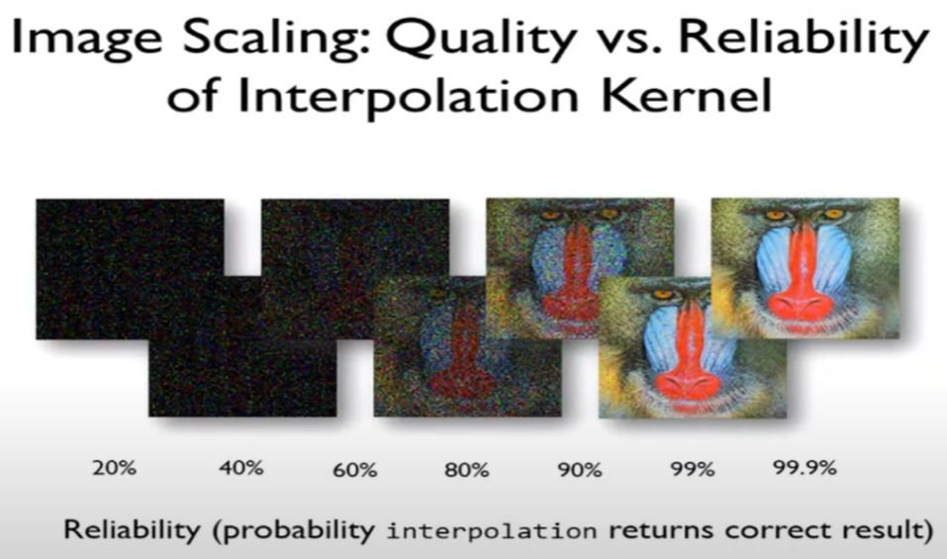
Real Life Examples

Slide 7
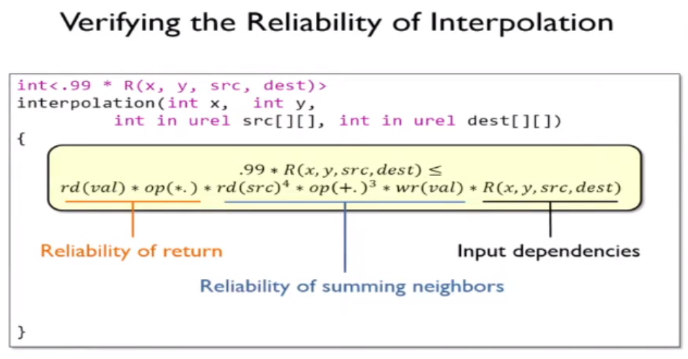
Under The Hood

Slide 8
Image Algorithm Demo

Slide 9
Practical Coding Demo

Slide 10
Closing Remarks

Slide 11

Approximate Computing
Presented by Marvin Sevilla

Slide 12
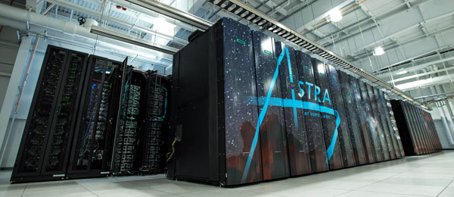
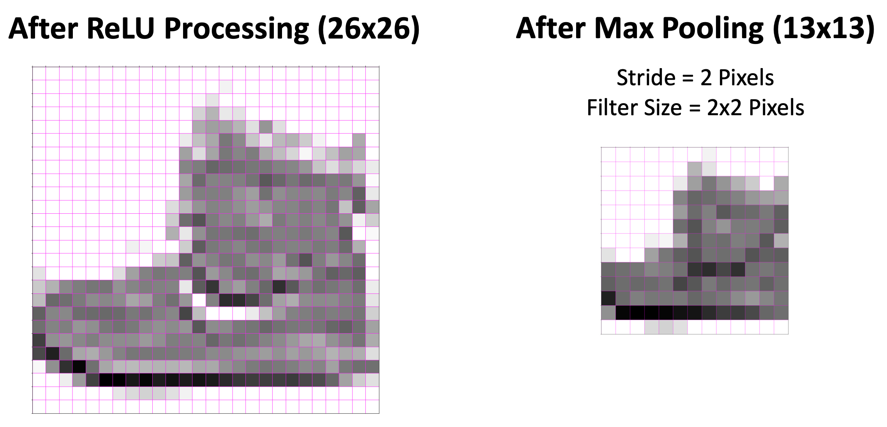
Approximate Computing
Presented by Marvin Sevilla
Overview
What is Approximate Computing
Real Life Examples
Practical Applications
Under The Hood
Image Algorithm Demo
Practical Coding Demo
Closing Remarks

Slide 13
Approximate Computing
Presented by Marvin Sevilla
Overview
What is Approximate Computing
Real Life Examples
Practical Applications
Under The Hood
Image Algorithm Demo
Practical Coding Demo
Closing Remarks
What is Approximate Computing?
A technique for achieving a satisfactory computational result with reliable and controllable error thresholds, yielding computationally faster algorithms that use less energy at the expense of lower quality results with negligible error

Slide 14
Overview
What is Approximate Computing
Real Life Examples
Practical Applications
Under The Hood
Image Algorithm Demo
Practical Coding Demo
Closing Remarks
What is Approximate Computing?
A technique for achieving a satisfactory computational result with reliable and controllable error thresholds, yielding computationally faster algorithms that use less energy at the expense of lower quality results with negligible error

Slide 15
What is Approximate Computing?
A technique for achieving a satisfactory computational result with reliable and controllable error thresholds, yielding computationally faster algorithms that use less energy at the expense of lower quality results with negligible error
Levels of Approximate Computing
Logic & Circuit
Microarchitecture (atomic functions)
Algorithms
Parameters

Slide 16
What is Approximate Computing?
It is undeniably faster and lower-power as it is unreliable
Domains of Approximate Computing
Logic & Circuit
Microarchitecture (atomic functions)
Algorithms
Parameters

Slide 17
What is Approximate Computing?
Domains of Application for Approximate Computing
Logic & Circuit
Microarchitecture (atomic functions)
Algorithms
Parameters
It is undeniably faster and lower-power as it is unreliable
Classes of Approximate Computing Techniques
Error Occurrence
Degradation
Level
Evaluation

Slide 18
What is Approximate Computing?
Parts of Every Approximate Computing Technique
Error Occurrence
Degradation
Level
Evaluation
Error Occurrence Degradation Level Evaluation
Domains of Application for Approximate Computing
Logic & Circuit
Microarchitecture (atomic functions)
Algorithms
Parameters
Errors can be either non-deterministic or deterministic
Non-Deterministic: happens randomly
Deterministic: able to consistently reproduce the same error

Slide 19
What is Approximate Computing?
Error Occurrence Degradation Level Evaluation
Parts of Every Approximate Computing Technique
Error Occurrence
Degradation
Level
Evaluation
Errors can be either non-deterministic or deterministic
Non-Deterministic: happens randomly
Deterministic: able to consistently reproduce the same error
Focuses on error rates and outcomes
Error Rate: The frequency and magnitude of errors (toggle-able or gradual degradation)
Error Outcomes: Can either be Bounded (Toggleable), Catastrophic (Toggleable and Gradual) or Graceful (Gradual)

Slide 20
What is Approximate Computing?
Error Occurrence Degradation Level Evaluation
Focuses on error rates and outcomes
Error Rate: The frequency and magnitude of errors (toggle-able or gradual degradation)
Error Outcomes: Can either be Bounded (Toggleable), Catastrophic (Toggleable and Gradual) or Graceful (Gradual)
Three Different Levels:
Transistor
Logic
Algorithmic

Slide 21
What is Approximate Computing?
Error Occurrence Degradation Level Evaluation
Three Different Levels:
Transistor
Logic
Algorithmic
Focuses on error rates and outcomes
Error Rate: The frequency and magnitude of errors (toggle-able or gradual degradation)
Error Outcomes: Can either be Bounded (Toggleable), Catastrophic (Toggleable and Gradual) or Graceful (Gradual)
Evaluation of approximate computing techniques from an atomic or application point-of-view

Slide 22
What is Approximate Computing?
Error Occurrence Degradation Level Evaluation
The ultimate success of an approximated application is its reliability
Reliability looks like executing the process multiple times, and the end-state of the relaxed version matches the original version a specified number of times, we deem the program reliable to that point
Evaluation of approximate computing techniques from an atomic or application point-of-view
Three Different Levels:
Transistor
Logic
Algorithmic

Slide 23
What is Approximate Computing?
The ultimate success of an approximated application is its reliability
Reliability looks like executing the process multiple times, and the end-state of the relaxed version matches the original version a specified number of times, we deem the program reliable to that point
Evaluation of approximate computing techniques from an atomic or application point-of-view

Slide 24
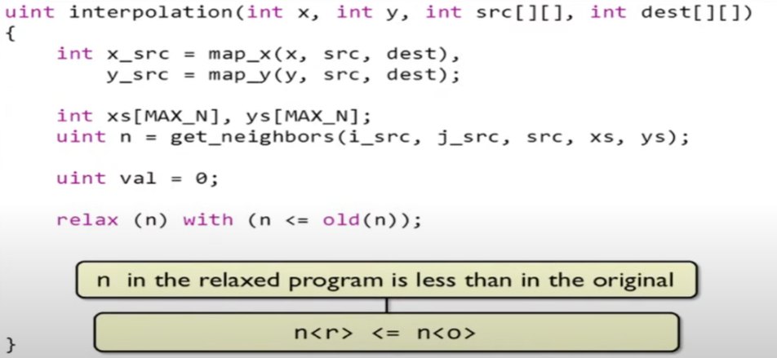
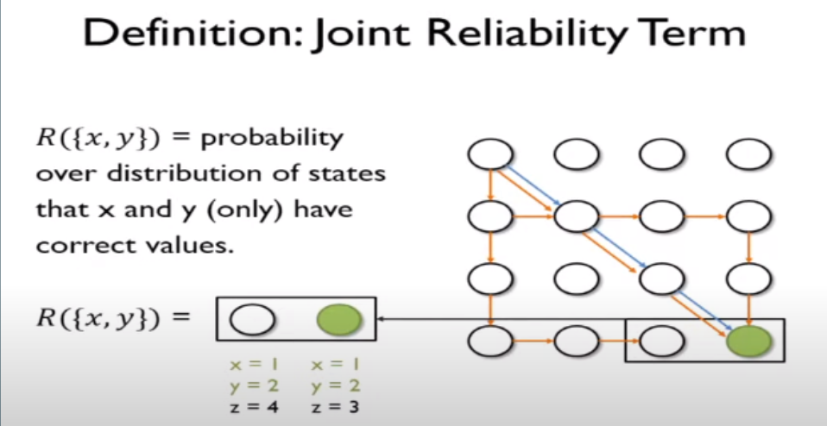
What is Approximate Computing?

Slide 25
Practical Application
What is Approximate Computing?
Approximation does not have to be a fixed feature in the system.
How Can You Use Approximate Computing Techniques?

Slide 26
Practical Application
What is Approximate Computing?
Approximation does not have to be a fixed feature in the system.
How Can You Use Approximate Computing Techniques?

